Slide 1
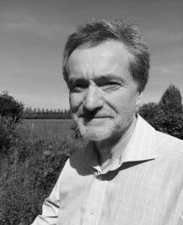
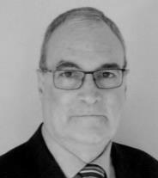
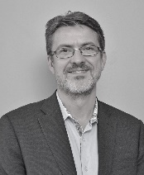
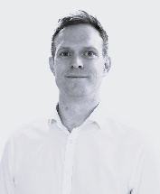
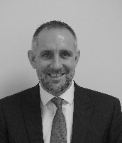
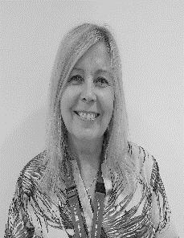
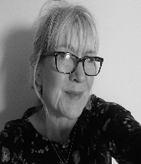
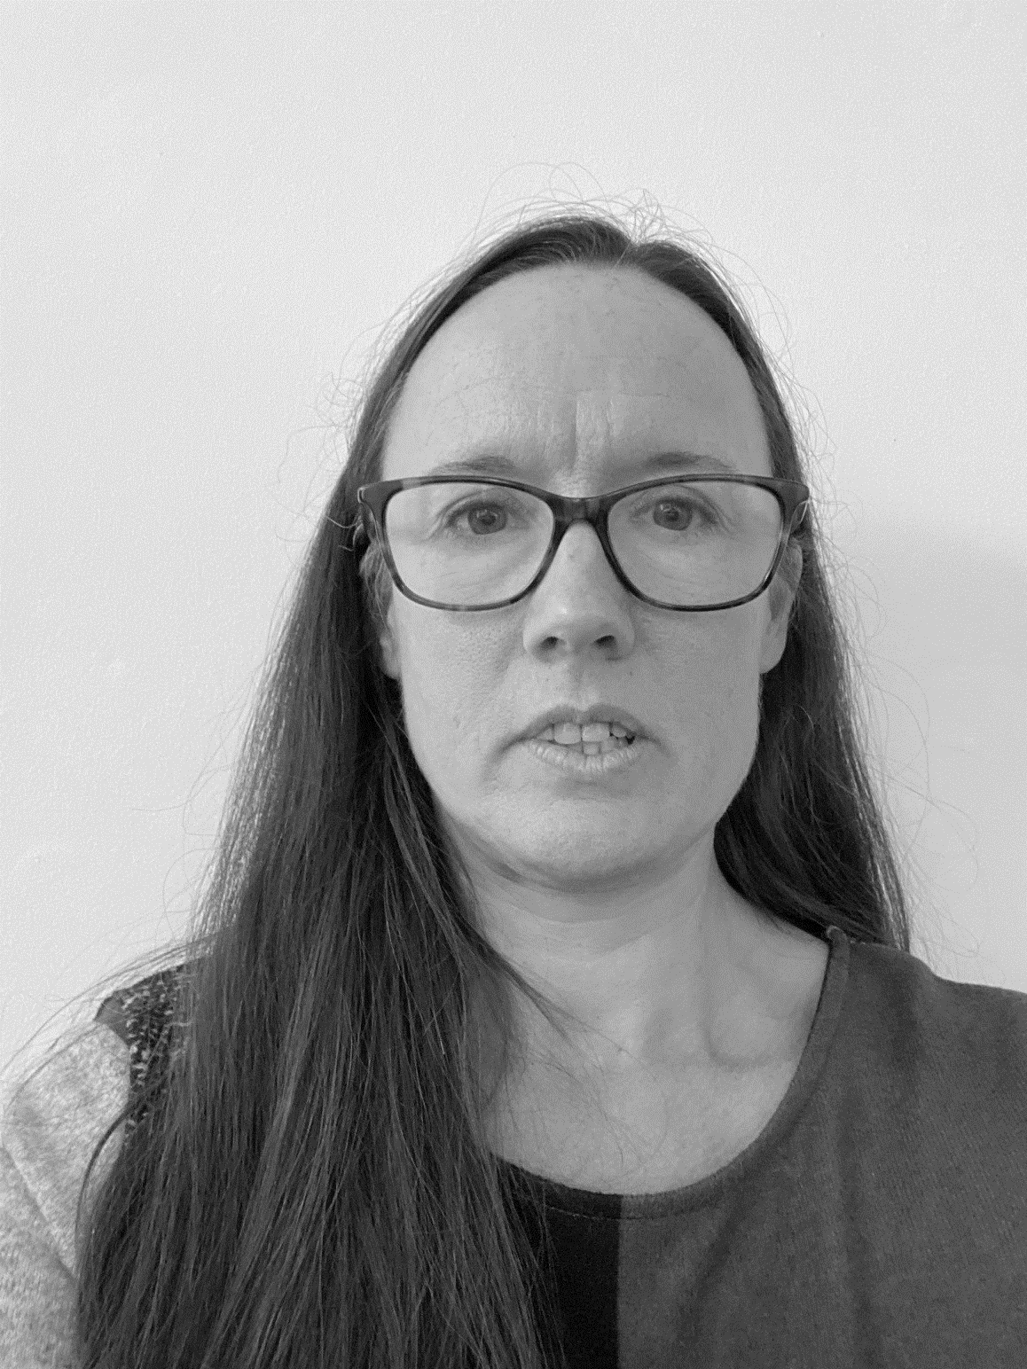
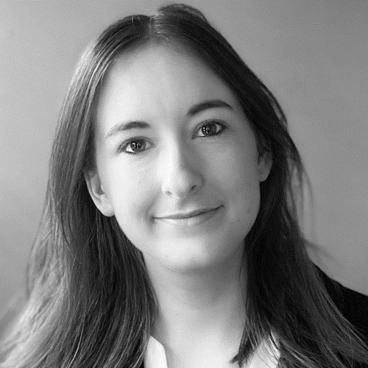
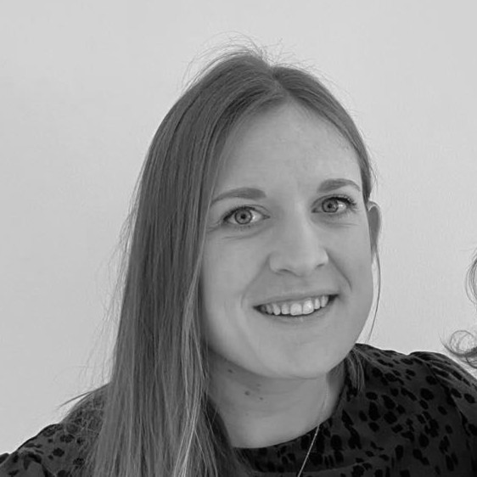
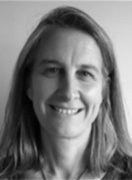
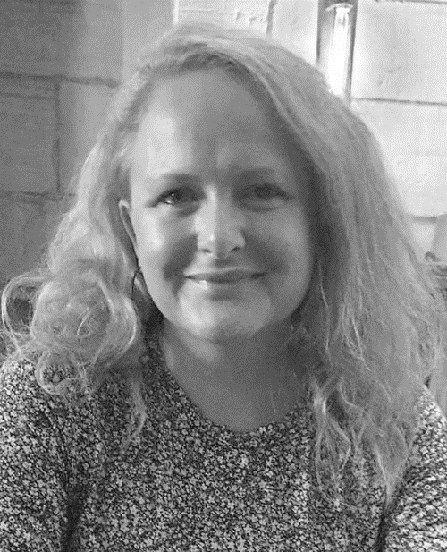
Wiltshire Health and Care’s Board, Executive Team
Last Updated: January 2025
Martyn Burke
Non-Executive
Director, Finance
& Audit
Richard Barritt
Non-Executive
Director, Patient
Voice
Stephen Ladyman
Chair of the Board
Andrew Hollowood
Non-Executive
Member (RUH*)
Niall Prosser
Non-Executive
Member (SFT*)
Simon Wade
Non-Executive
Member (GWH*)
Shirley-Ann Carvill
Managing Director
Jo Meacham
Acting Chief
Operating Officer
Rayna McDonald
Director of
Quality and
Professions
Nikki Rowland
Interim Director
of Finance
Andrea Benham
Corporate
Governance Lead
and Company
Secretary
Niamh Hughes
People Lead
Victoria Hamilton
Associate Director
of Infrastructure
Becky Watson
Corporate Services
Business Manager
*RUH: Nominated by Royal United Hospitals Bath NHS Foundation Trust
*SFT: Nominated by Salisbury NHS Foundation Trust
*GWH: Nominated by Great Western Hospitals NHS Foundation Trust

