Slide 1
Digital Literacy
Bath and Northeast Somerset, Swindon & Wiltshire (BSW) Allied Health Professionals (AHP) support workforce 2023
Rachel Davis (née Churchman), May 2023

Slide 2
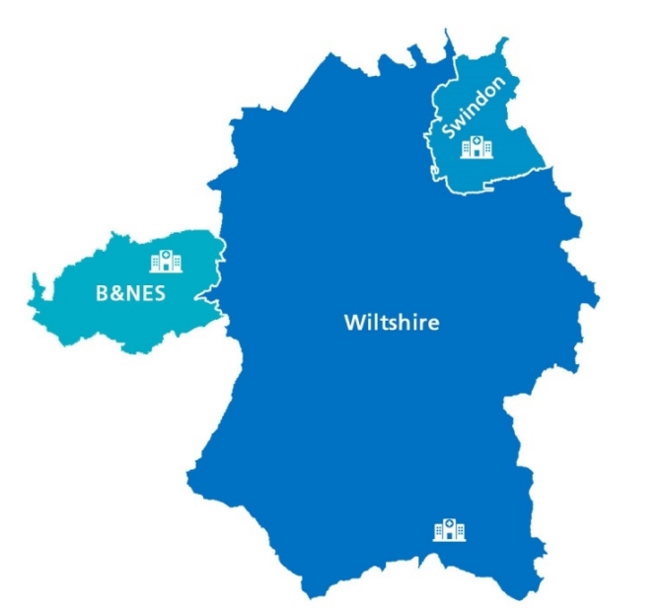
Health Education England (HEE) defines digital literacy(-ies) as: “the capabilities that fit someone for living, learning, working, participating and thriving in a digital society.”
Notes:
I.E the ability to use digital technology/ devices functionally in your day-to-day life (work, home, shopping, holiday, finances, childcare etc.)
HEE funded BSW AHP Faculty – digital lead role. We decided to use the funding to carry our digital literacy scoping exercise, focussing on our bands 2,3,4,5 and equivolent AHP support workfore across BSW as this tied in and add value with our other faculty projects.
Funding granted based from the recommendations of the 2019 Topol Review - which advocates for the necessity of innovative use of digital technology in healthcare for proven staff and patient benefit.

Slide 3
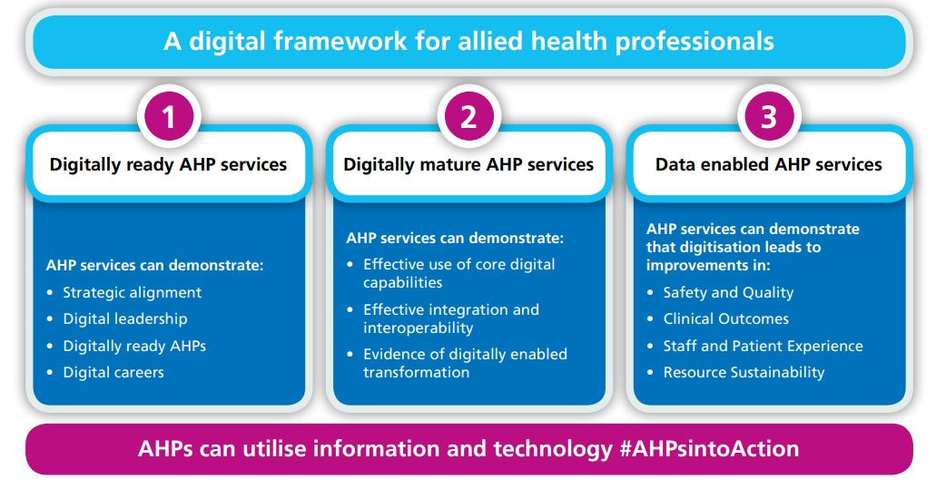
NHS England: A Digital Framework For Allied Health Professionals
Notes:
It is advised by both the Topol Review and NHS England, that increasing our digital and technological use/skills within healthcare will increase our efficiency, reduce risk of errors, support our environmental sustainability pledge, and support our communications [2]. The NHS Long Term Plan commits one of its five ambitions to “making better use of data and digital technology”; including more convenient access to services and health information for patients, better access to digital tools and patient records to staff and using the NHS App as a ‘digital front-door’ [3]. Subsequently, digital literacy is one of the four priorities of ‘AHP’s into Action’ and is supported into practice within ‘The Digital Framework for Allied health Professionals’ [4]. This emphasis on prioritising NHS digital transformation and ‘going paper-free’ comes from the identified need in both the UK government’s ‘Five Year Forward View 2020’ and the ‘Wachter Report, 2016’ [5],[6].
A Digital Framework for Allied Health Professionals (england.nhs.uk)
To achieve the desired digital framework for AHPs, NHS England identify the three stages of digital readiness which each organisation should measure against when planning their digital strategy:

Slide 4
Aim:
To record the current digital literacy skills of our BSW AHP support workers and identify any themes in competency.

Slide 5
The Self-Assessment Survey:
Domain 1: General Digital Skill
Domain 7b: Personal Professional Asset and Resource Digital Skills
Domain 9: Digital Therapeutics Skills
Notes:
Kept as close to the original text from the AHP digital competency framework advices by Christopher Tack (Topol Fellowship who based his framework off of Topol’s review).
31 questions
Some slight changes to eliminate a bias tone to the questioning and simplify it for the participants as per pilot feedback.
Digital, paper and phone formats to access wider participant pool.
Domain 1 - comprised of 10 questions around participants’ general simple digital use in their AHP profession. This looked at their awareness and attitudes towards digital healthcare, their ability to learn and facilitate learning of digital skills, their ability to evidence their digital skills, their use of digital technology to enhance their continued professional development (CPD), and their use of electronic health record documentation in their roles.
Domain 7b - this section probes the participants’ abilities to perform personal professional digital functions (e.g. completing HR requirements, accessing occupational health, managing their electronic staff record (ESR) to access payslips, total reward statements and absence calendars). As well as the use of electronic rostering.
Domain 9 - This final section explored the ability and use of digital therapeutics. This encompassed a multitude of platforms due to this project looking at all 14 AHP groups. This included online patient bookings, physical and psychological therapeutic apps, identifying clinically assured health signposting, virtual communications and clinics, and digitally capturing patient data at the point of care.

Slide 6
Sample:
109 fully completed surveys revealed that samples were acquired from 7 out of the 8 organisations within BSW participated, these include:
Wiltshire Health & Care
Royal United Hospitals Bath
Great Western Hospital, Swindon
Salisbury Hospital
Avon & Wiltshire Mental Health Partnership Trust
HCRG
Swindon Borough Council

Slide 7
Notes:
Good, representative sample

Slide 8
Themes
Training
Electronic Health Record (EHR)
Apps
Capturing patient data

Slide 9
Training:
Digital platforms to roll out training would be beneficial and preferable to the majority of our workforce (over 85% reported average or above ability of use).
Around a quarter of our staff require some additional training, likely face to face to get up to par.
51% reported less than average knowledge and understanding of local training resources available to enhance digital health literacy of professional and public.
Notes:
Over 85% of participants reported that they have average, or above, abilities to electronically record, learn and facilitate learning of digital skills; as well as navigate digital platforms in order to achieve this (questions 4 & 5). This indicates that using digital platforms to deliver training would be an effective method of roll-out for the vast majority of our BSW workforce.
Question 13 highlights that as many as 51% of participants reported having less than average knowledge and understanding of local support and training resources available to enhance digital literacy for both professionals and the public. With a concerning 15% reporting they have no knowledge or understanding.

Slide 10
Electronic Health Records (EHRs)
79% felt able to document to their organisation's standards on EHR.
8 % unable to do so to an average ability
7 % reported not being able to document on EHRs at all
6 % reported that they have no requirement to digitally record due to their workplace using paper notes.
Notes:
This is despite the recommendation from NHS England that “AHP services as a minimum should be aiming to capture their records, assessments and care plans digitally in a format that supports their service, partner services and patient/service user needs. This is a core foundation for developing digitally mature AHP services.”
Given the target to be paper-free with digital notes was 2018 (5 years ago!), [NHS challenged to go paperless by 2018 - GOV.UK (www.gov.uk)
PTO…

Slide 11
Notes:
This is worsened further by the fact that 100% of participants reported they had at least limited knowledge and ability of simple computer skills, with 92.7% declaring their skills as above average (question 9).
This lends us to believe that the lack of EHR competency is likely a result of inaccessibility and/ or software specific training requirement, rather than general digital literacy barriers. This conclusion appears evidenced by the results of question 13, which show that less than 50% (48.6%) of participants had average knowledge and understanding of the training and resources available for both professionals and the public.

Slide 12
Healthcare Apps:
NHS app, mHealth, Hope For The Community, MDCalc, Keele Pain Recorder
(e.g. IAPT, Woebot Health, Hub for Hope).
Physical health – Less than half, (48%), of our BSW AHP support workforce participants felt they have average or above ability to signpost our patients to physical health apps.
Mental health - “One in four adults experiences at least one diagnosable mental health problem in any given year” [NHS England], and yet almost half of participants, (47%), reported no knowledge or understanding, or use of this field of digital therapeutics.
Training is required for being able to identify clinically assured digital content, as 6% reported no ability and 18% reported limited ability. There was also a discrepancy around those reporting being able to identify clinically assured resources and those that can signpost to clinically assured resources.
Notes:
This becomes more important still given the extensive wait lists for face-to-face interventions of stretched services across the UK. Additionally, with WHO recognising that “Mental health conditions now cause 1 in 5 years lived with disability” [16], accessibility is another factor that needs considering. And so for someone suffering from a mental health condition, using an app from the safety of their own home may be more realistic way that they can reach the support that they need.
60.2% of participants felt they had average or above ability to know how to identify clinically assured digital resources; it becomes worrying that 69.7% reported that they had average or above ability to direct patients to clinically assured on-line health and care information .
The concern being that a proportion of staff that report they are lacking the ability to identify whether a digital resource is clinically assured but are happy to signpost patients to resources regardless of this. It may be the case that 69.7% felt more confident in signposting patients to the specific, well known, examples I gave (e.g. NICE guidelines), but this could also be a case of 69.7% felt more confident signposting patient to online resources than knowing/ identifying the validity of the resources.
How well they could identify non-clinically assured / inaccurate online health and care information, which 80.8% reported average or above ability in. Meanwhile, 18.3% reported less than average ability and worryingly of these 6.4% reported no ability. With our current and future digitally weighted methods of communicating with each other, (e.g. news aps, e-papers, social media, forums, blogs, vlogs etc.), it becomes more important than ever to be able to ascertain for ourselves what is medically assured / accurate due to the open nature of publication on various digital platforms
Adult and older adult mental health, NHS England, NHS England » Adult and older adult mental health
Adult and older adult mental health, NHS England, NHS England » Adult and older adult mental health

Slide 13
Capturing Patient Data:
The area for most development…
Handheld devices: e.g. tablet, phone,
mHealth wearables: e.g. KiActiv device
Medical devices: e.g. blood pressure or blood glucose monitoring, pulse oximeter
Digital cameras: e.g. photos of wounds in the community to upload to EHR for referral
Remote monitoring: e.g. clinical notes, test results, virtual wards
Image exchange portal e.g. sending/receiving an image with another hospital for a transferred patient.
Remote working: e.g. home or community working
Notes:
The highest score being only 56% felt able to remote work from a laptop to an average or above ability
The lowest scoring only 21% average or above ability to use mHealth wearables - KiActiv
Handheld devices, imagine exchange portals. , medical devices, digital cameras and remote monitoring all scored between just 27% to 55% of participants reporting average or above ability.

Slide 14
Notes:
Handheld devices: 25.7% of participants reporting being completely unable to use handheld devices in this way. With only 43.1% reporting average or above ability to use handheld devices for capturing patient digital data.
mHealth wearables: Almost half, 45.5%, reported being completely unable to use mHealth wearable technology to capture digital patient data. Only 20.5% felt they have average or above ability to view and use wearable devices in their work setting. This is surprising given the popularity of fitbit/ apple watch etc. Mention BSW KiActiv commission??
Medical devices: 23.4% reported being completely unable to use connected medical devices to capture patient physical parameters (e.g. blood pressure or blood-oxygen saturation readings). 55% reported average or above ability.
Digital cameras: 33.6% reported being completely unable to use digital camera technology to facilitate medical image capture and recording in electronic health records (EHR) (e.g. with patient’s consent, photographing a wound and uploading the digital image to the patient’s EHR for registered staff review). 32.7% reported average or above ability to use digital camera technology to capture patient data. This is only one employee more than those reporting no ability at all.
Remote monitoring: 36.4% reported being completely unable to use remote monitoring of patient HER data (e.g. viewing clinical notes & test results). 37.3 % reported average or above ability to use remoted monitor patient HER data. Again, this is only one employee more than those reporting no ability at all.
Image exchange portals: 40.4% reported being completely unable to use image exchange portals (IEP) to capture or view patient data. 26.6% reported average or above ability to use IEPs. Given the specialist nature of IEPs I do not think this is as great a training / development area as the numbers may suggest.
Remote working: 20.2% reported being completely unable to use remote working methods (e.g. laptops) to capture or view patient data whilst remote working (e.g. in patient’s homes or community settings). 56% reported average or above ability to capture and view patient data whilst remote working.
I think the most surprising theme of this category of data, is that between 12.6% - 20.5% of participants reported that using each digital data capturing method was not applicable to them. Given the future of healthcare in our digital age, the advancement in our digital and technology software/ devices/abilities and the overall positive attitude of our BSW AHP support workers I am surprised that so many reported that they felt it was not applicable to them. While I accept that certain modalities would not be applicable in certain areas of professions, I would not expect to see as many as 20.5% report so.

Slide 15
Key take-aways:
Overall digital literacy is actually already relatively high in at least three quarters of our AHP support workforce.
There is also already a majority proportion of our AHP support workforce with a positive attitude towards further enhancing their digital literacy and digital innovation in their field of work.
There is a big disconnect of awareness around what digital innovation is available and happening in the different allied health professions.
There is also a lack of knowledge of the training available and our workforce hearing/knowing about it and how/where to access it and find out more.
Digital platforms for training are the majority preference, these largely already exist and so it should be a simple piece of work around our signposting to the available resources.
Notes:
76.1% of the AHP support workers who participated felt that they could demonstrate to an average or above ability that their values and behaviours embrace digital and technological innovation.

Slide 16
What you can do
Status
quo
Educate yourselves on what digitally innovative practice is happening in your profession and how you can get involved
SHARE updates with your colleagues
Work with your education & training departments to ensure clear signposting for our training resources
Advocate for our support staff having protected time and access to fulfil their digital training needs.
Challenge and address why some of us still aren’t using electronic health records
Utilise clinically assured health apps in your professions
Continue to lead by example
Progress
Notes:
1.) Educate: Unions, IT and education & training departments, SW digital AHP network
2.) SHARE: e-mails, agendas, meetings, journal club, social media etc.
3.) Work: Digital Learning Solutions Platform Welcome - Digital Learning Solutions (dls.nhs.uk)
4.)Advocate: wifi connectivity and space and access to computer
5.)Challenge: Given the target to be paper-free with digital notes was 2018 (5 years ago!), NHS England state“AHP services as a minimum should be aiming to capture their records, assessments and care plans digitally in a format that supports their service, partner services and patient/service user needs. This is a core foundation for developing digitally mature AHP services.”
6.) Utilise: guidelines available, speak with your information governance officer if requiring assistance , GOV & NICE guideline available
(Criteria for health app assessment - GOV.UK (www.gov.uk))
7.) Continue:

Slide 17
Any questions?
Full report and anonymised data available via: https://wiltshirehealthandcare.nhs.uk/about-us/freedom-of-information/ or whc.legal@nhs.net
Contact: Rachel.Churchman@nhs.net
: Rachel.Davis@ghc.nhs.uk

